Slide 1
Bamazon
bamazonCustomer.js

Slide 2
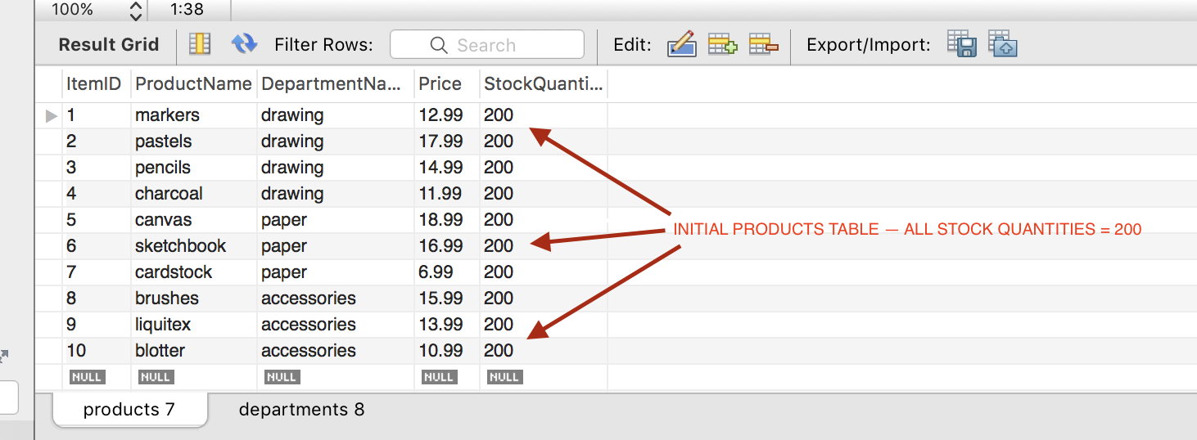
MySql database – shows initial “products” table where all quantities = 200

Slide 3
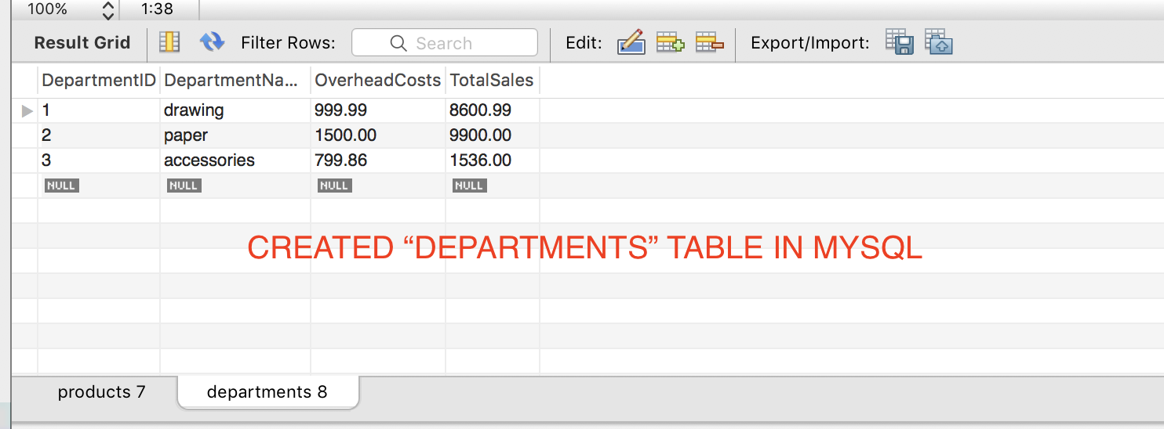
MySql database – shows initial “departments” table (but I didn’t get to code “Level 3” of the HW exercise in JS.

Slide 4
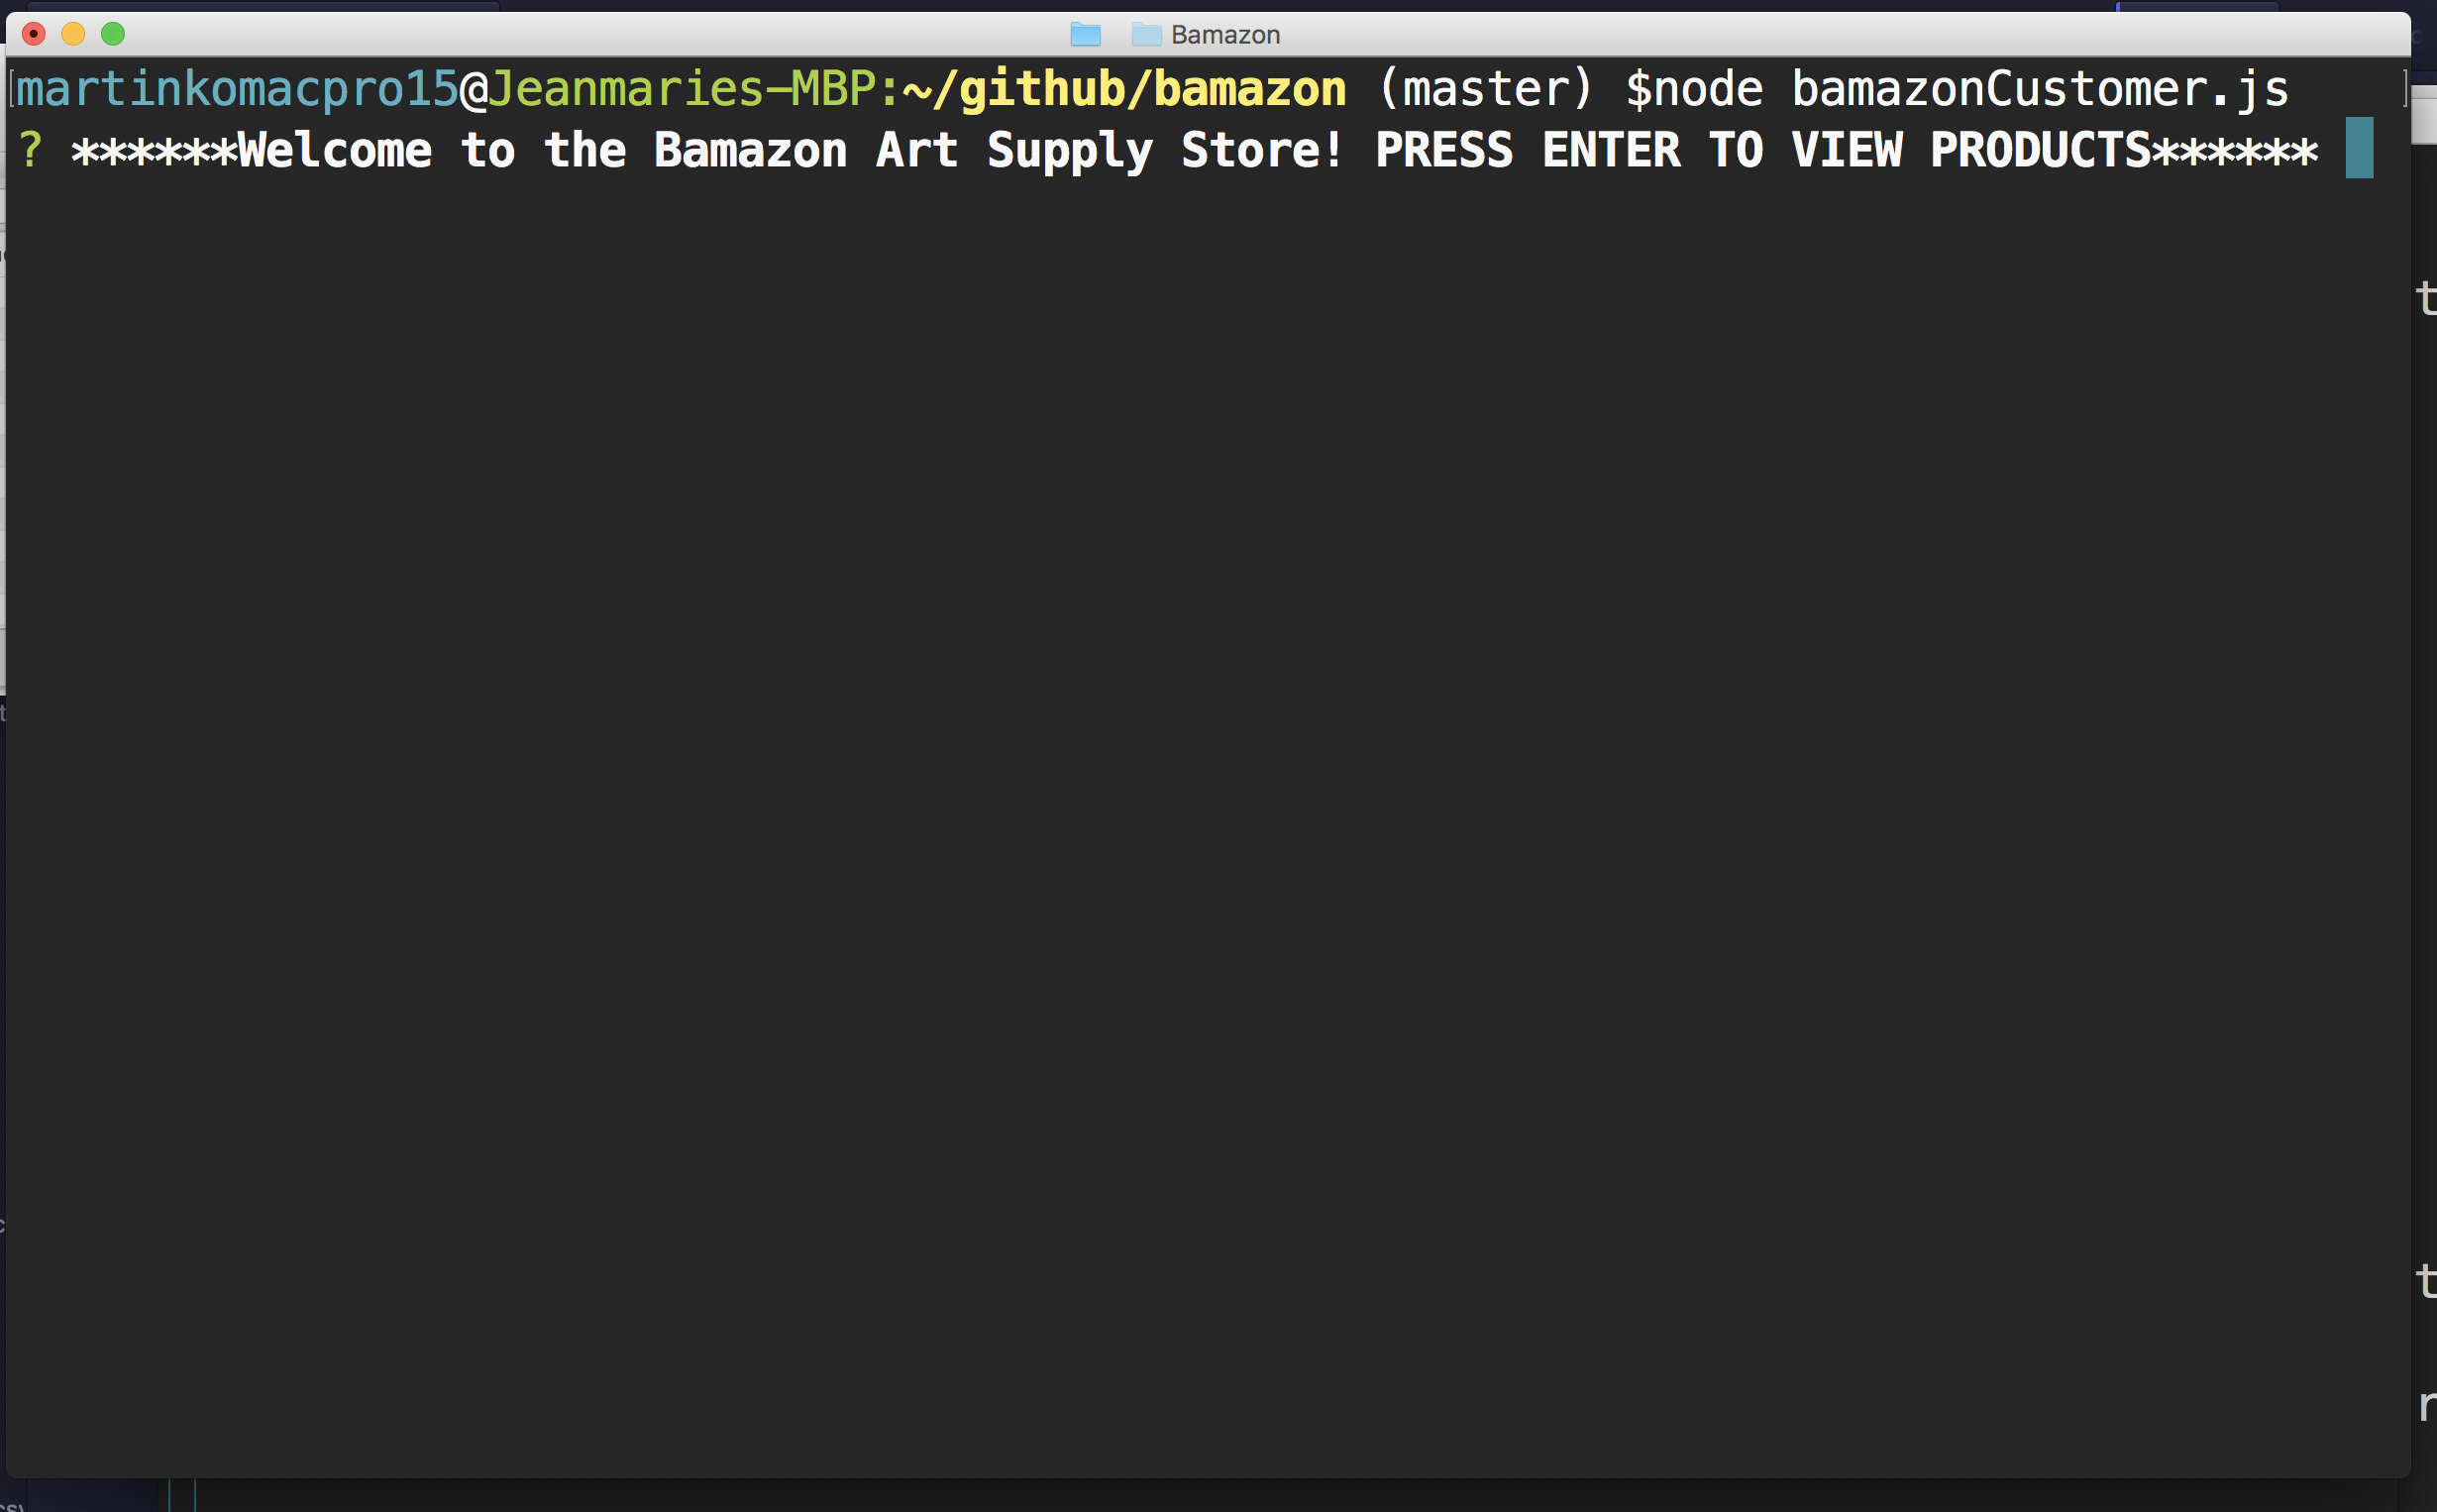
Starting bamazonCustomer.js. . .

Slide 5
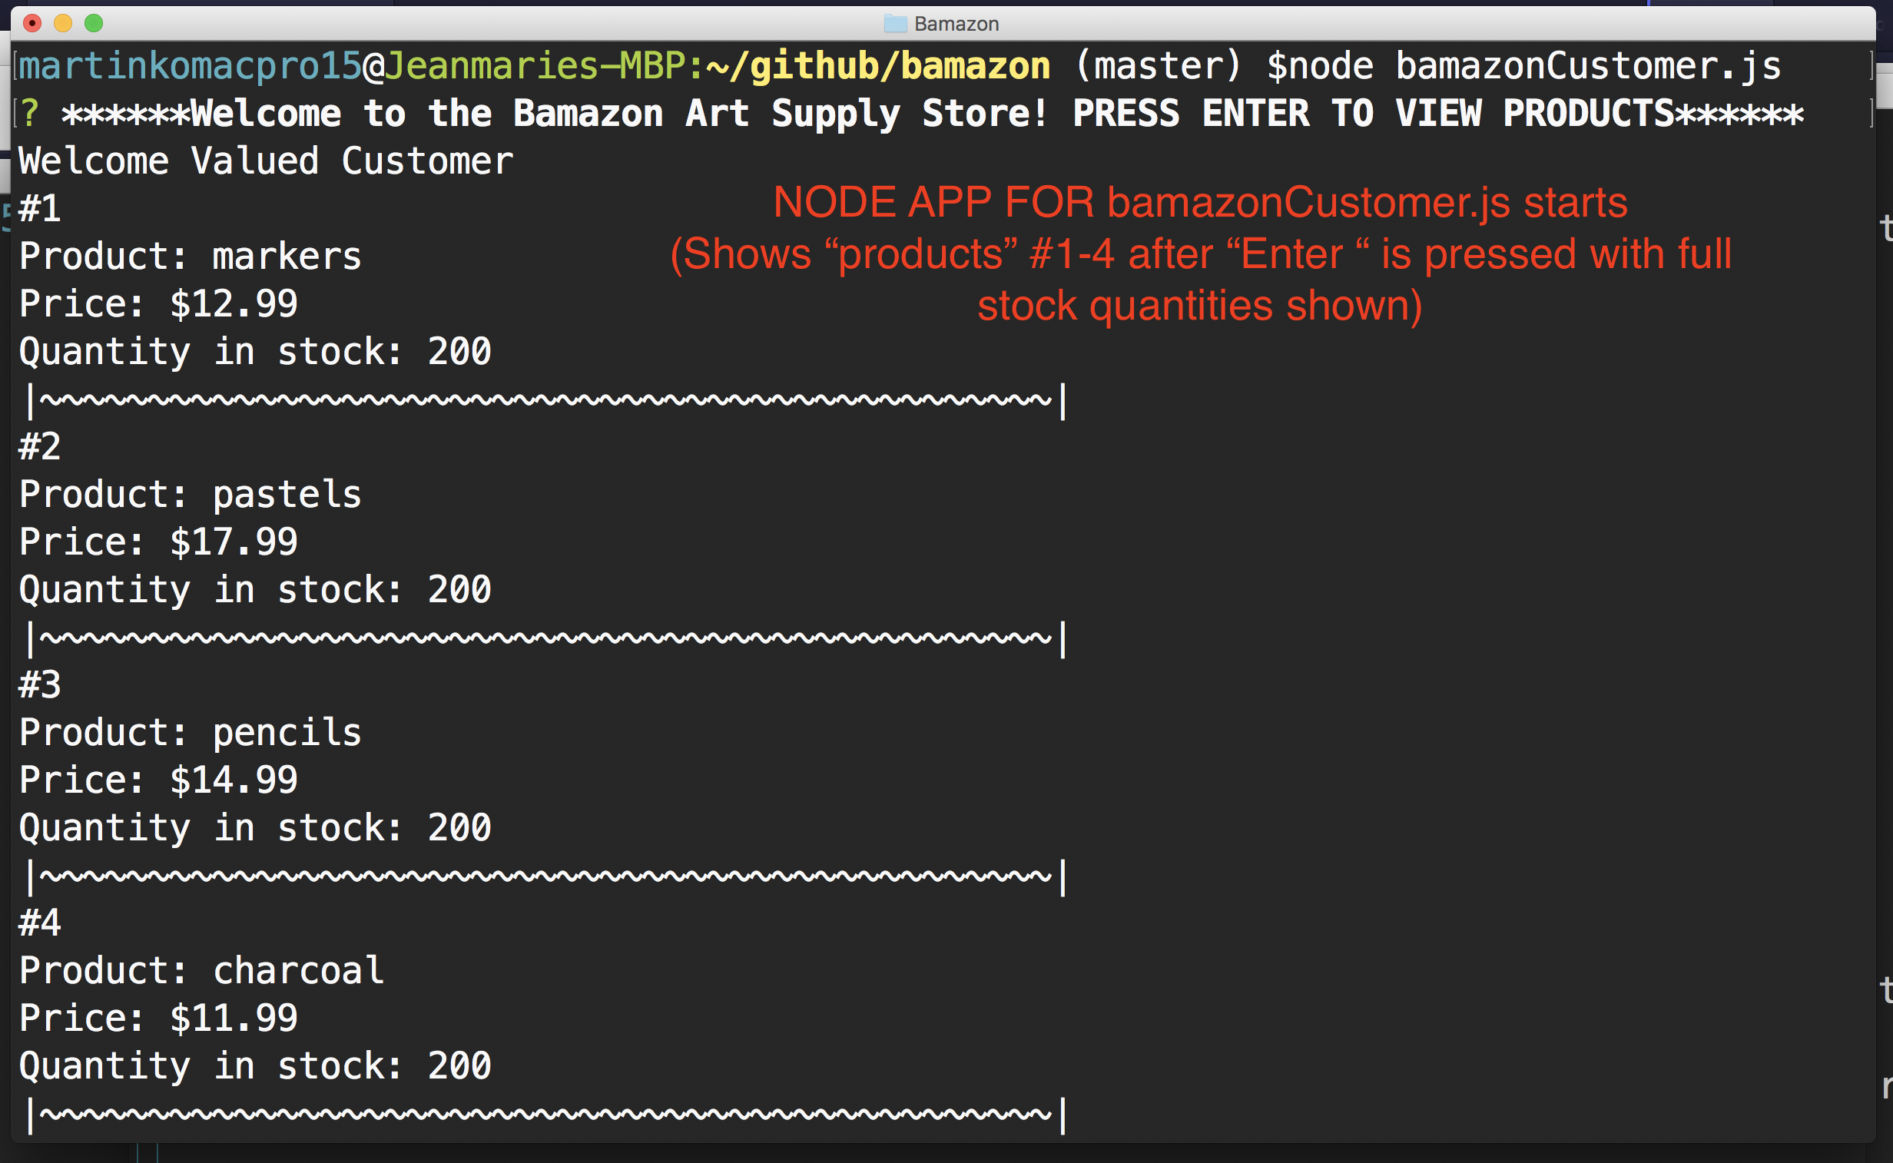
Shows Products #1-4 after “Enter” is pressed with quantity=200 for all products (200 initial stock). . . . .

Slide 6
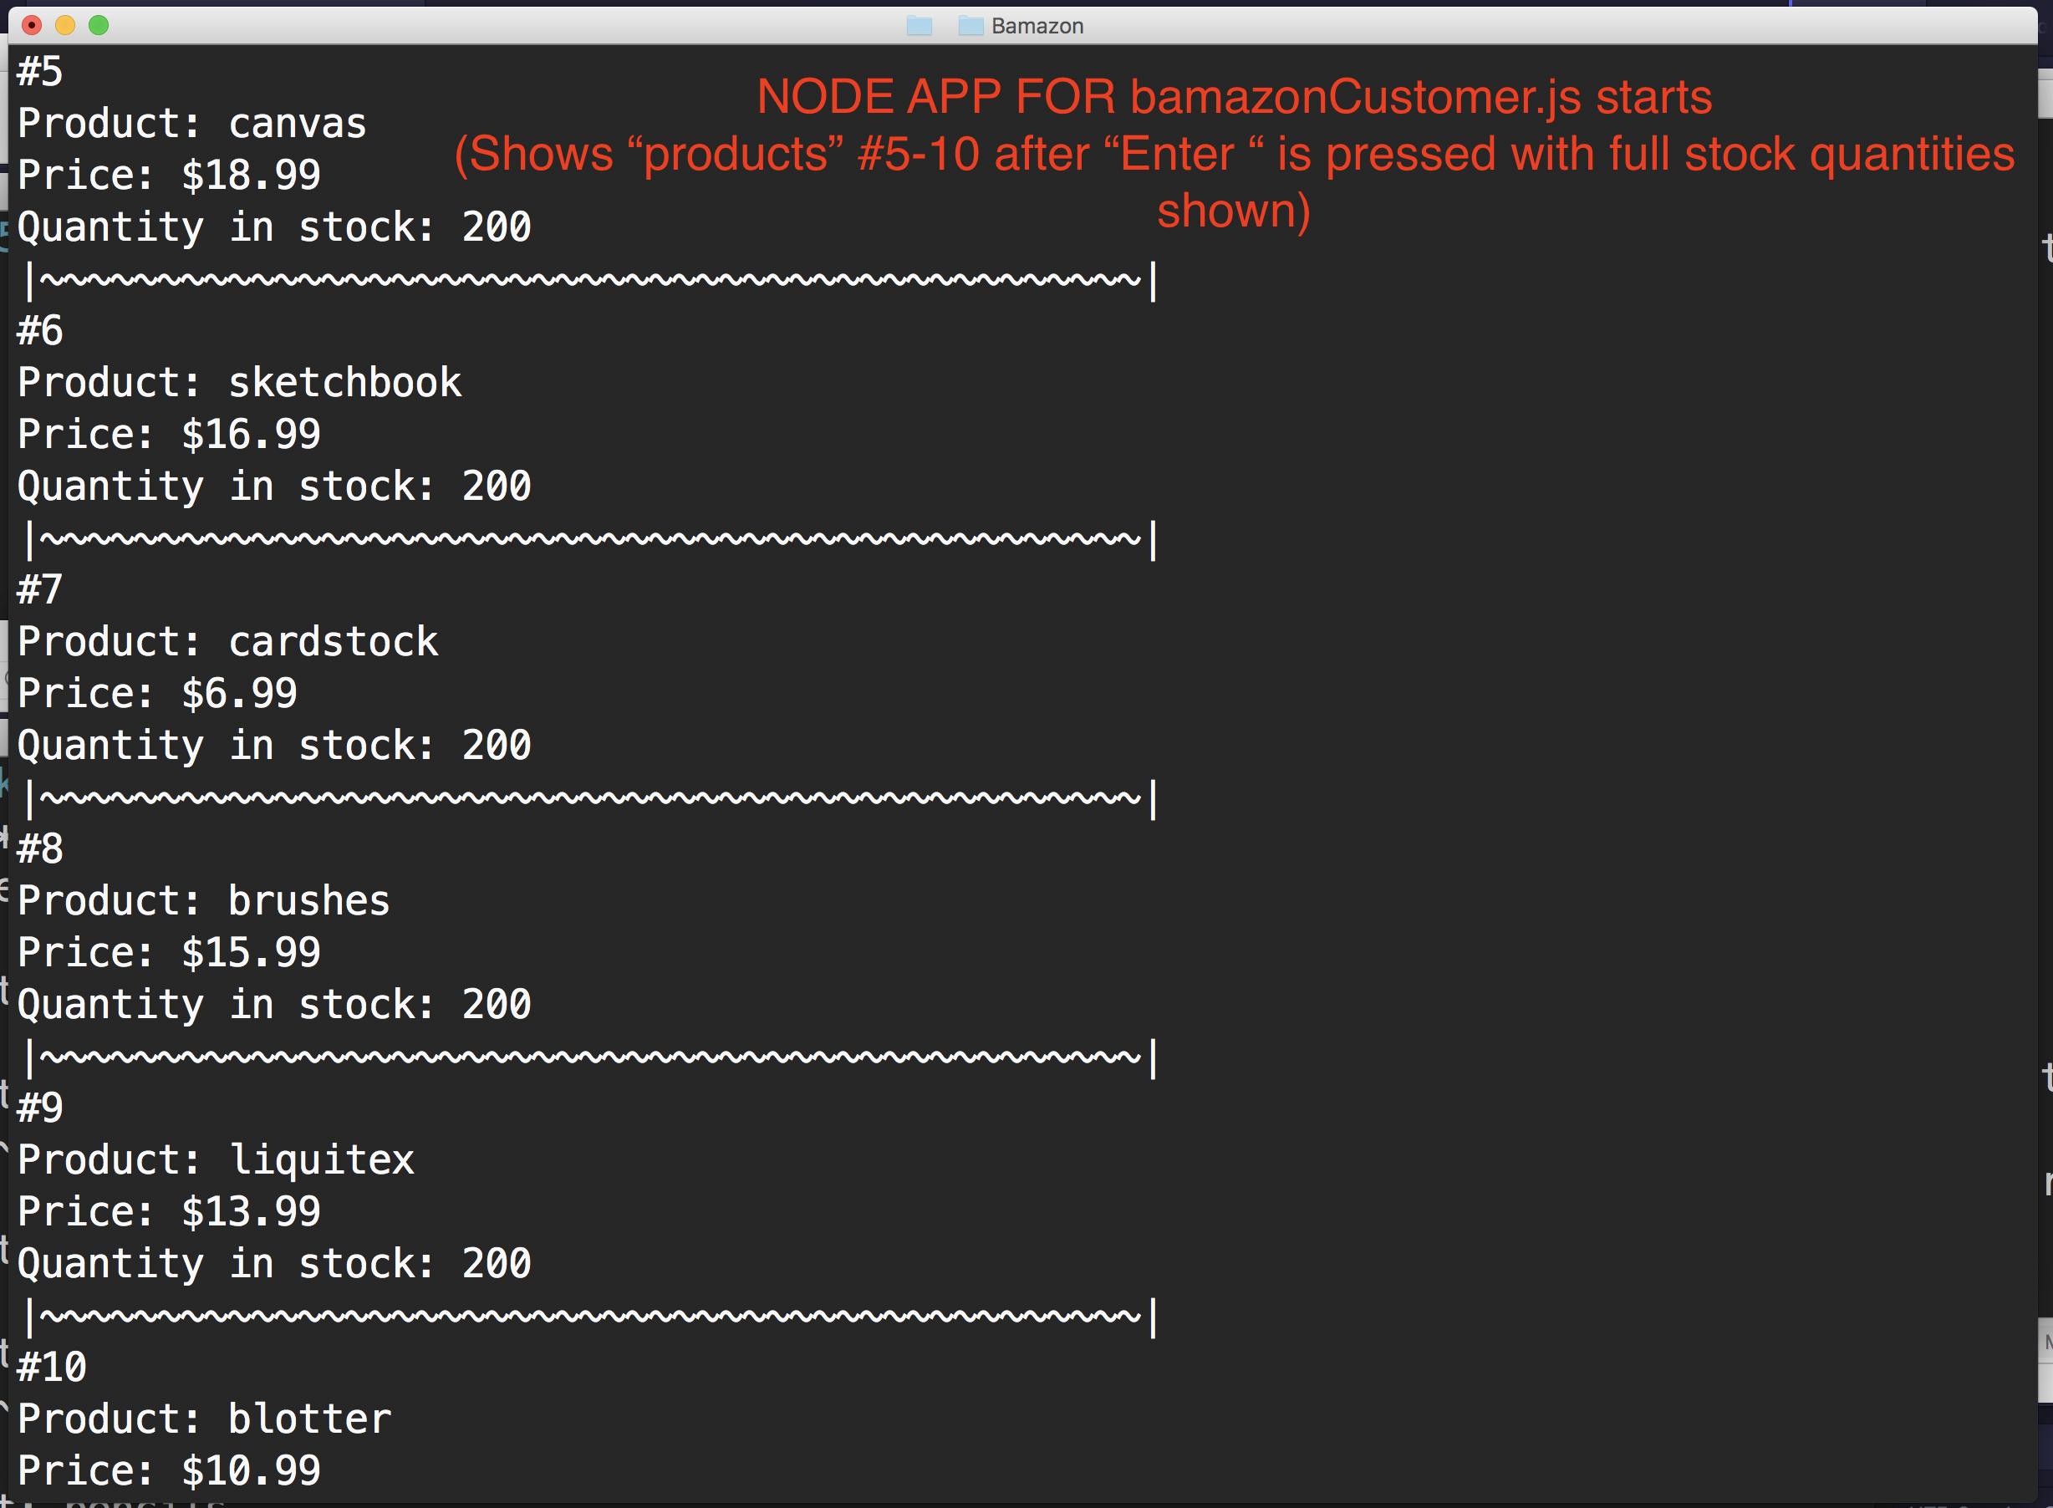
Shows Products #5-10 after “Enter” is pressed with quantity=200 for all products. . . . .

Slide 7
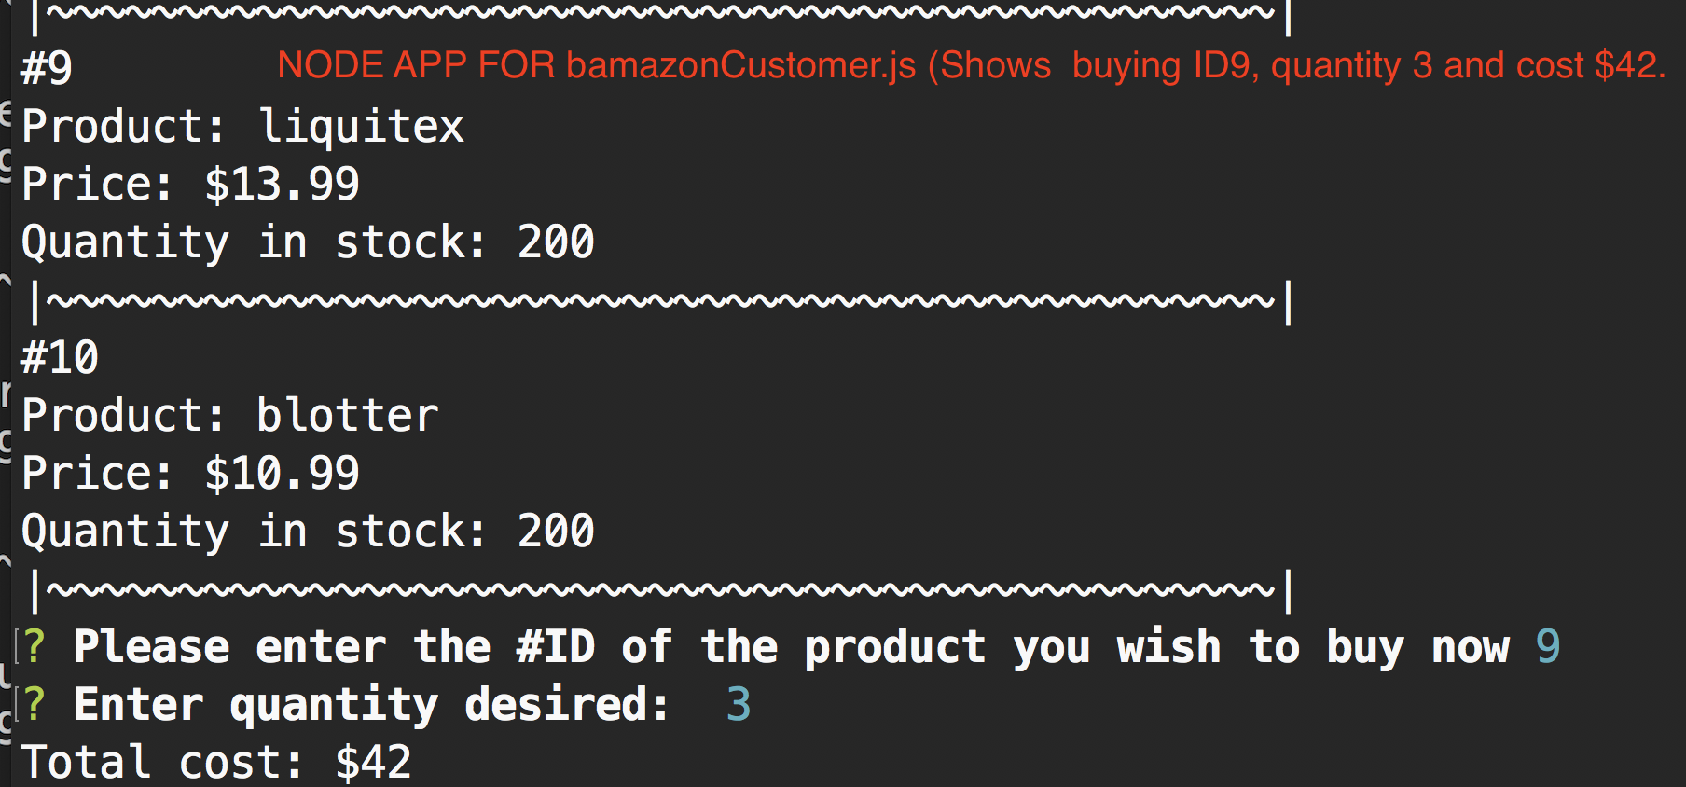
. . .Prompts and responses for item to be purchased (#9 Liquitex), quantity (3) and calculation of total cost ($45). . .

Slide 8
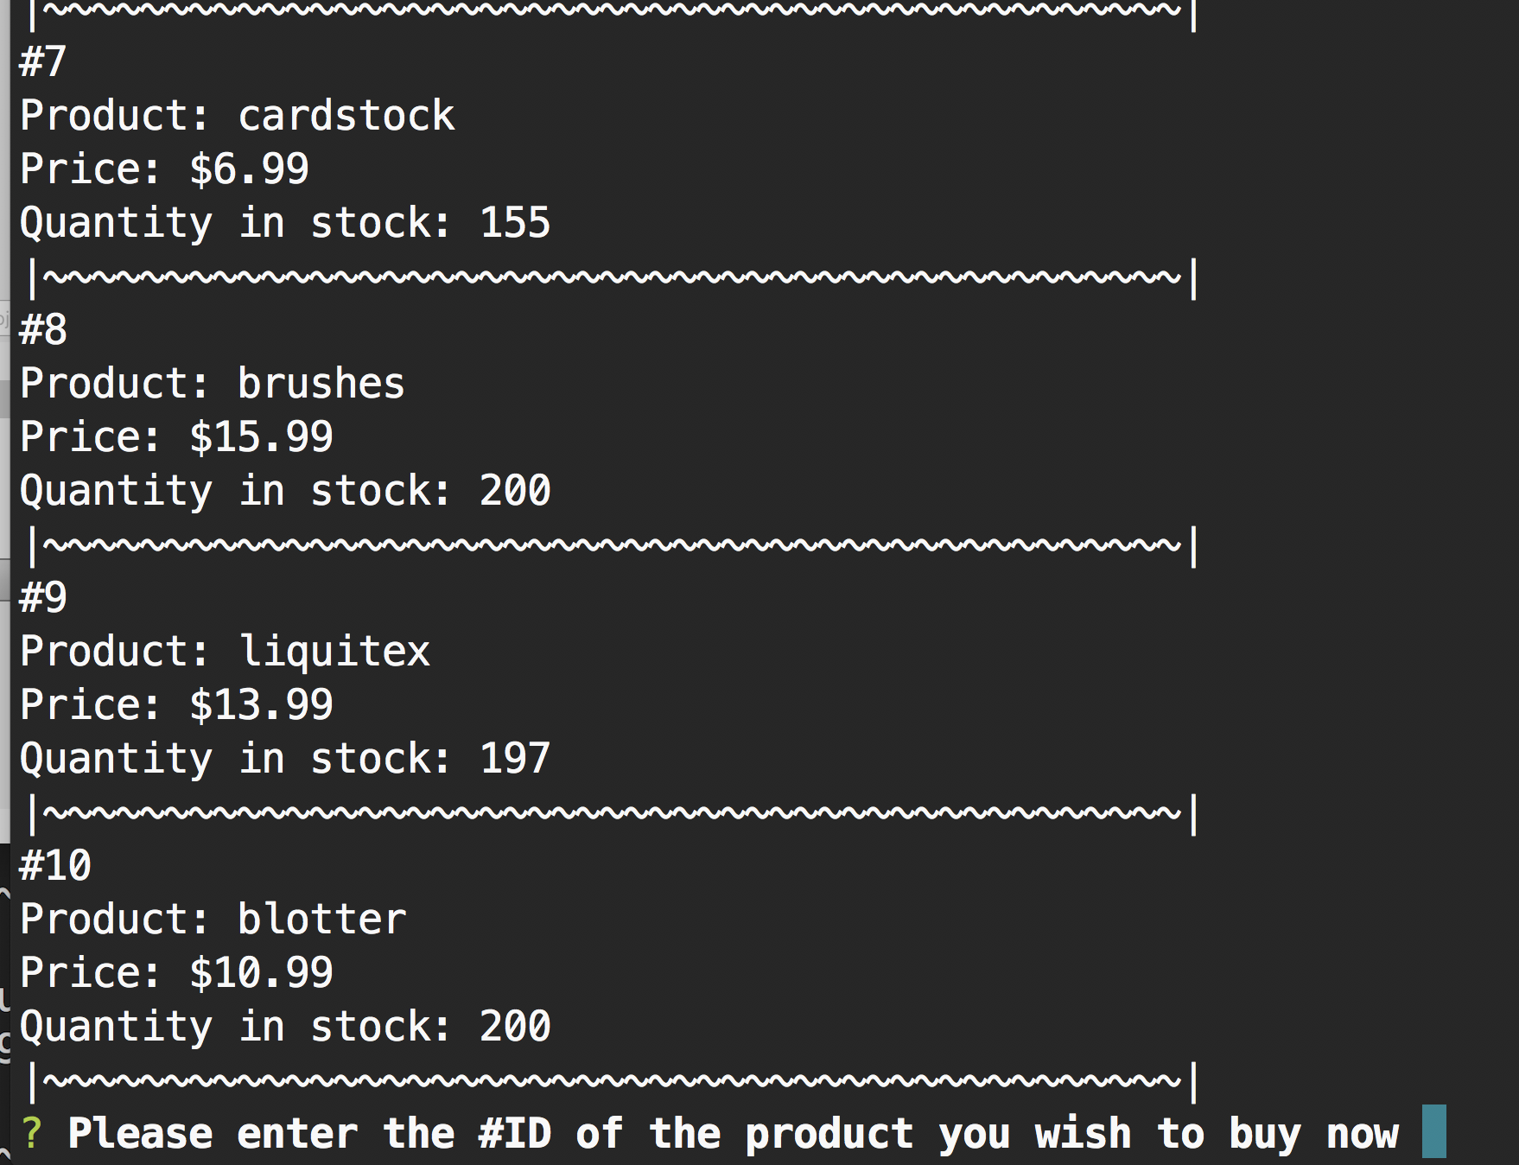
. . . The quantity of available stock is then updated to reflect that 3 units of #9 (Liquitex) were purchased. . . .

Slide 9
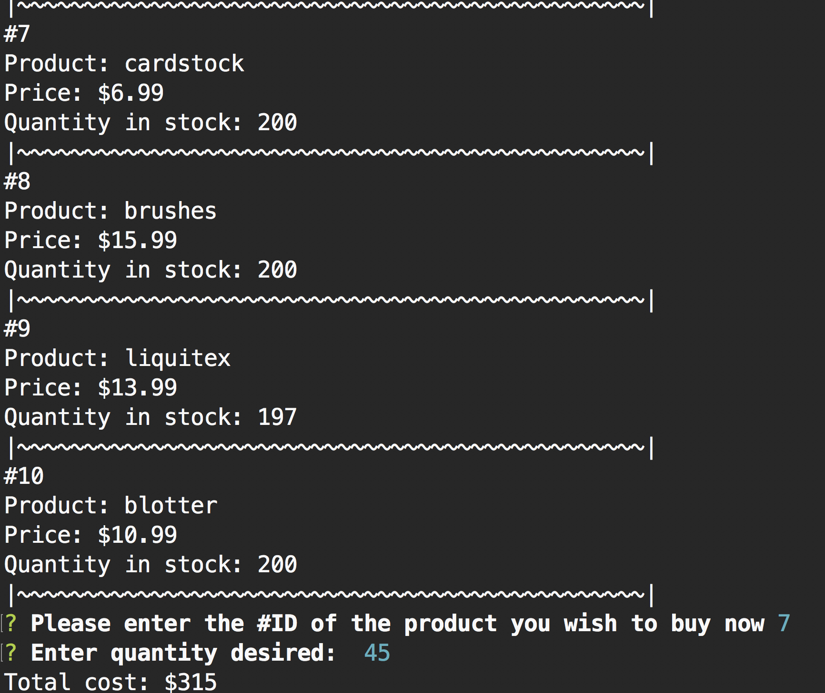
. . .Next. . .Prompts and responses for item to be purchased (#7 cardstock), quantity (45) and calculation of total cost ($315).. . .

Slide 10
. . . The quantity of available stock is then updated to reflect that 45 units of #7 (cardstock) were purchased. . . .

Slide 11
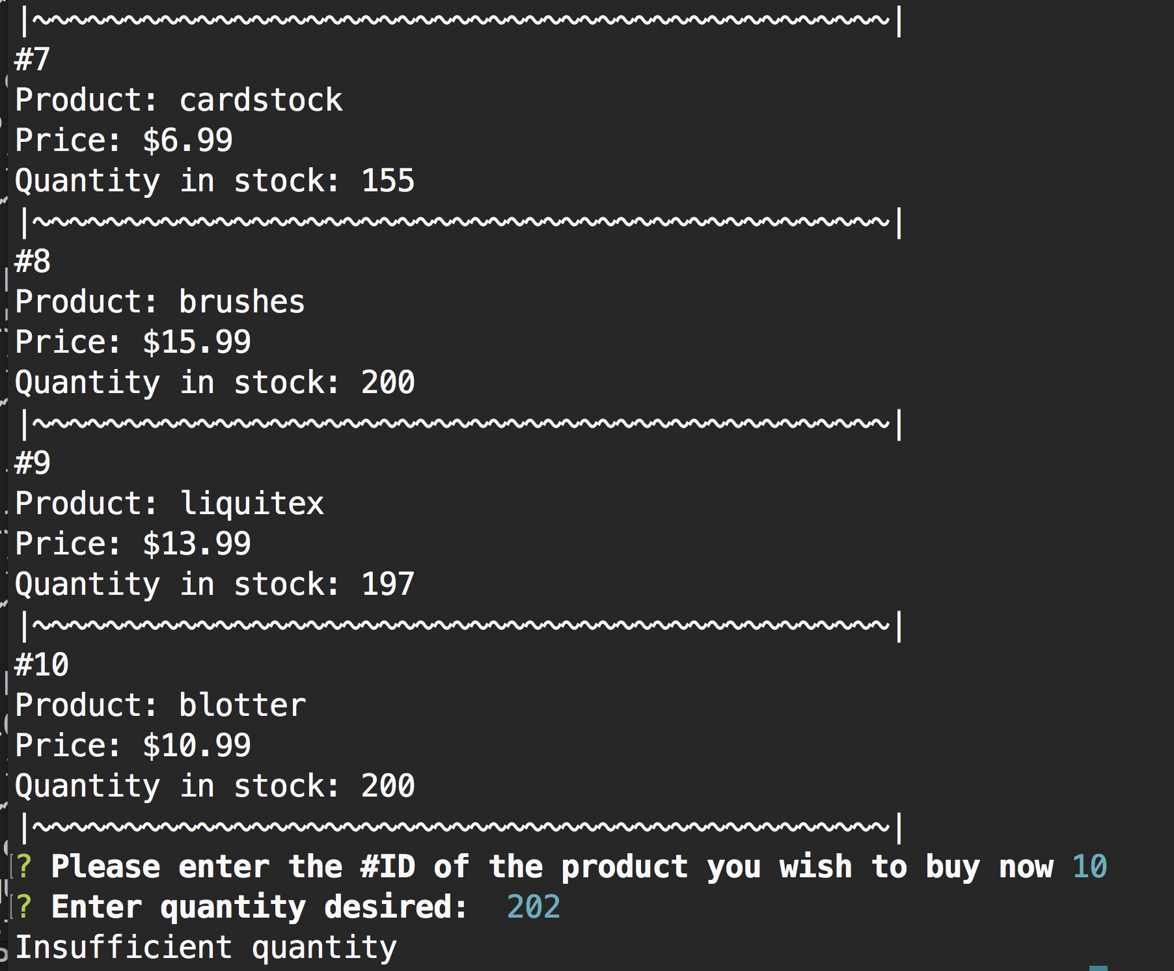
. . .Next. . .Prompts and responses for item to be purchased (#10 blotter), quantity (202) and response of “Insufficient quantity” is returned since there were only 200 in stock . . . .

Slide 12
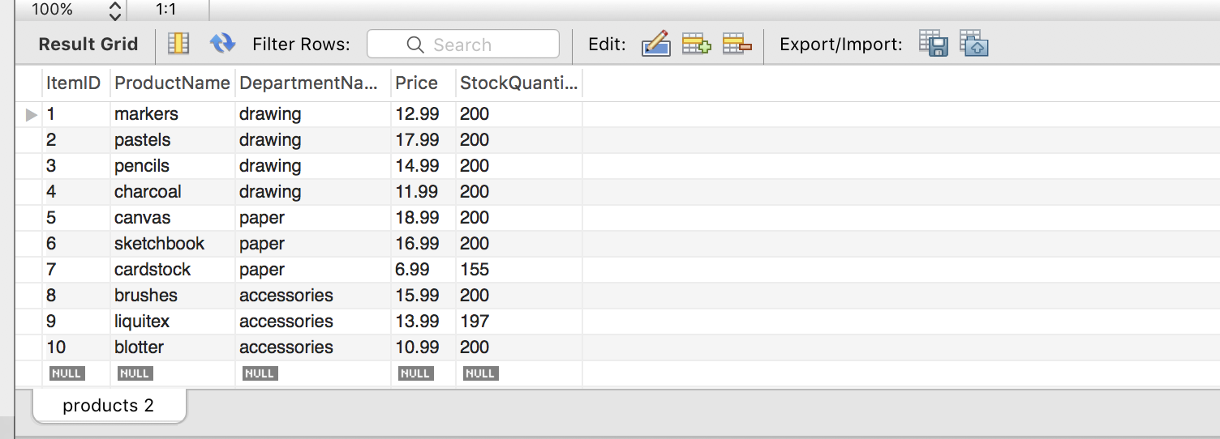
MySql database – shows “products” table after purchases were made and quantity of stock modified . . . .

Slide 13
The End
bamazonCustomer.js

